Slide 1
[Podcast]Paragraf and NPL demonstrate that graphene Hall Effect sensors are ready for high-radiation applications
Dr Ivor Guiney, Co-founder of Paragraf
Tuesday September 15th 2020
Copyright © 2020 Paragraf Limited. All rights reserved
Notes:
Title Page
Theme Text: Eras Medium ITC
Theme Colours: Paragraf Red, Paragraf Grey, Paragraf Secondary Grey, Black

Slide 2
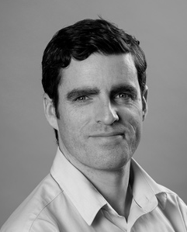
Introduction to Paragraf
Launched in 2017 as a spin-out from the Department of Materials Science at Cambridge University by Professor Sir Colin Humphreys, Dr Simon Thomas and Dr Ivor Guiney
Currently over 40 employees (and expanding!) with 43% in R&D
Custom R&D and in-house production facility, just outside Cambridge
Prof. Sir Colin Humphreys – CBE, FREng, FRS
CSO
Sir Colin has extensive experience in the commercialisation of scientific ideas and the creation of successful university spin-out companies.
Dr Simon Thomas – MEng, CPhys, CEng
CEO
Simon has a diverse background in physics, engineering and materials science combined with many years’ experience in the fields of semiconductors, functional materials, solid state devices and capital equipment manufacture.
Dr Ivor Guiney –
MPhys
Technical Director
Ivor’s expertise is centred on semiconductor device design and production, thin film material synthesis and capital equipment manufacture, which spans physics, chemistry and materials science.
Notes:
Standard Text Page

Slide 3
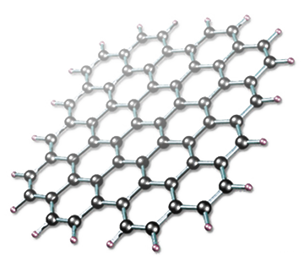
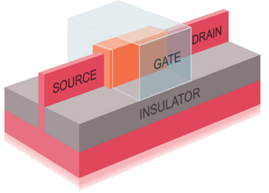
Graphene Innovation
Realising two-dimensional materials technologies
Delivering for the first time transformative, game-changing graphene based electronic device technologies at commercial quality & scale
Paragraf’s goal is to deliver the long speculated graphene based devices enabling next generation electronics technologies, for the benefit of the global community
Paragraf’s focus is on the development of two-dimensional materials and graphene based electronic technologies

Slide 4
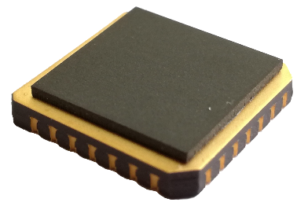
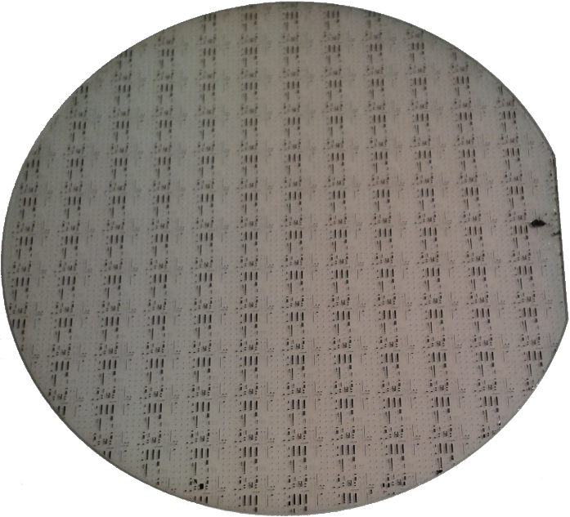
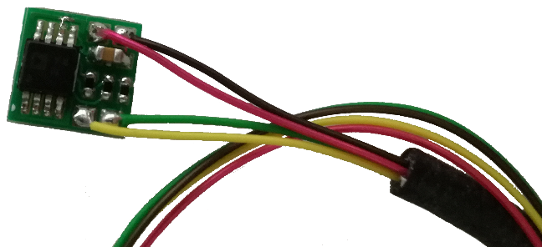
Graphene Technology
devices
Wafer scale graphene enables wafer scale device fabrication, processing & production
Paragraf graphene is directly compatible with standard semiconductor device manufacturing & processing lines
Paragraf devices have already demonstrated step change improvements of existing technologies
Graphene electronic devices become possible at commercial scale
Notes:
New Photo’s required for internal presentation

Slide 5
Why graphene Hall Effect sensors?
High sensitivity
Low carrier concentration
Wide field measurement range
High sensitivity (amplification not required)
Robustness
Strength & resistance to thermal & electrical shock
Radiation tolerance
Low noise
High carrier mobility
Low power consumption
High sensitivity / low drive current
Impervious to stray fields
No planar Hall effect – truly 2D
Ease of calibration
Repeatable linearity & temperature coefficient
Simple polynomial fit for non-linearities
Wide operating temperature range
Thermally stable and limited material interfaces
Notes:
Standard Text Page

Slide 6
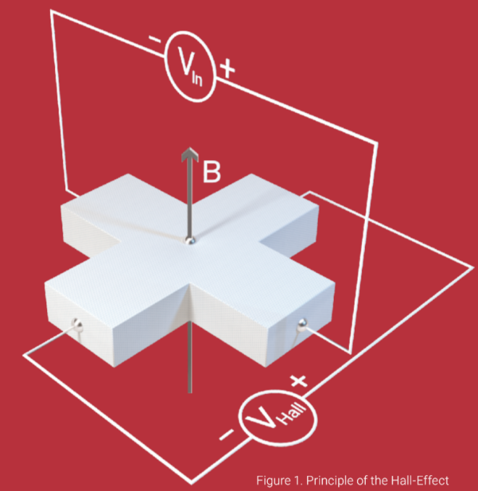
Planar hall effect
Lack of a planar Hall effect – discovered in collaboration with CERN
As graphene is a 2D material the device does not produce spurious signals from non-orthogonal fields. This improves field mapping accuracy.
Full characterisation confirms:
The magnitude of the planar Hall effect is at most 10⁻⁵ T in a 1 T field
Two orders of magnitude better than any other ‘bare’ Hall element
At least as good as a Hall sensor with built in planar Hall effect compensation
Yet smaller, cryo-capable and able to measure a wider dynamic field range
Notes:
Repeatable curve

Slide 7
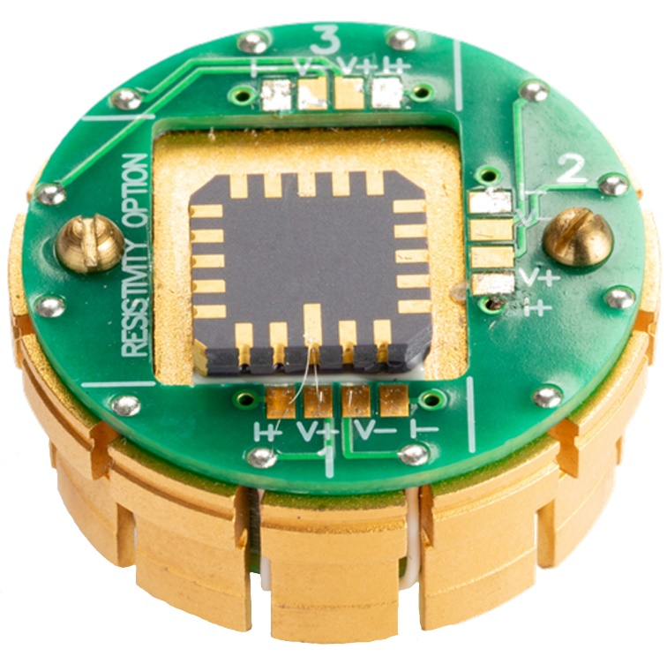
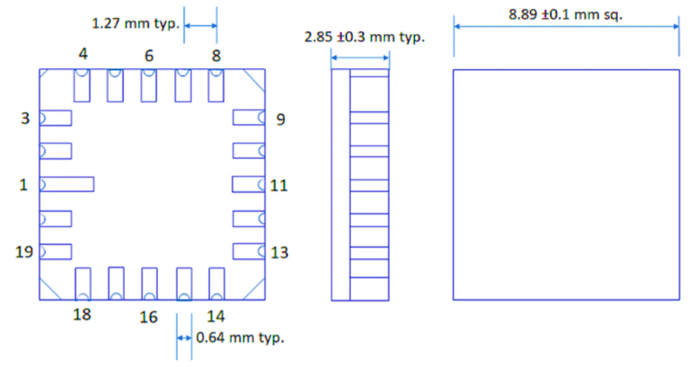
The GHS09CC graphene Hall effect sensor
Notes:
Standard Text Page

Slide 8
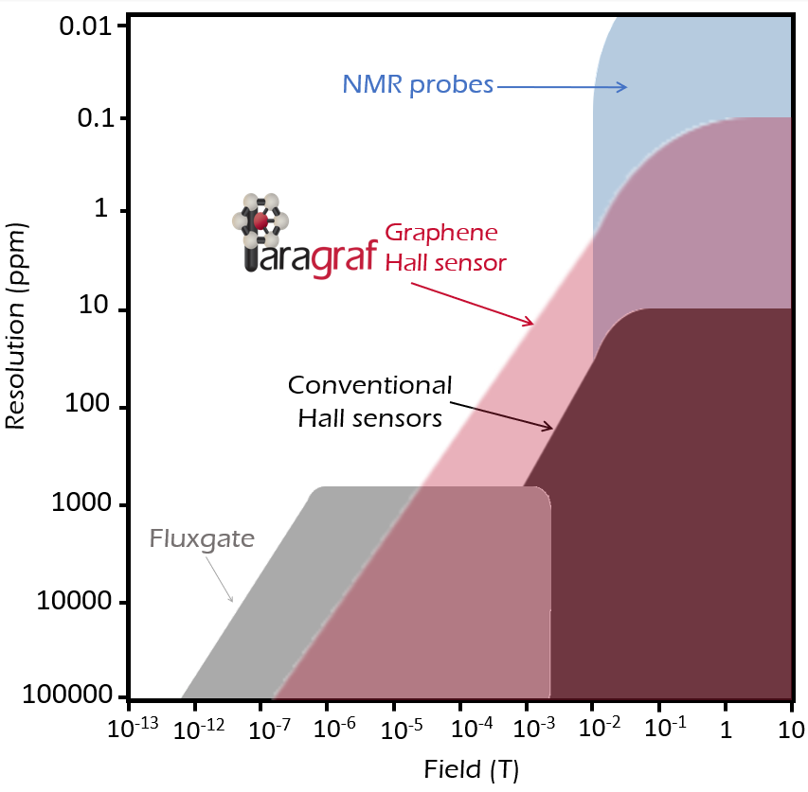
The GHS09CC graphene Hall effect sensor
The GHS overcomes many of the shortcomings of conventional magnetic sensors…
 | Types of Magnetic Field Sensors – typical performance
Critical Sensor Properties | Hall sensor | Fluxgate | NMR probe | Paragraf GHS
Maximum achievable resolution (on a 1 T field) | 10 ppm | 0.5 ppb | 10 ppb | <200 ppb
Specified field range (T) | +/- 3 T | +/- 0.01 T | ~0.3 T per probe | +/- 9 T
Planar Hall Effect (T) | 1 x 10 ⁻³ | N/A | N/A | <1 x 10 ⁻⁵
Minimum power dissipation | 1 MW | >>MW | >>MW | 5 pW
Cryogenic use?
Gradient field measurement?
Size & weight | Small | Large | Large | Small
…providing an ideal combination of the best features from each & paving the way to new magnetic sensing capabilities
Notes:
Standard Text Page

Slide 9
What’s new?
Paragraf has now demonstrated the ability of its graphene Hall Effect sensors to withstand high levels of radiation
Following testing by the National Physics Laboratory (NPL) in the UK, it was proven that ‘unpackaged’ graphene Hall Effect sensors can be used in high-radiation environments such as space
The project was funded by Innovate UK, the UK’s innovation agency, and is due to run until the end of 2020

Slide 10
Why is it important?
Historically, the deployment of Hall Effect sensors in high-radiation environments has faced significant challenges, such as a more complex, lengthy, and costly manufacturing process
By contrast, tests conducted by NPL have shown that, following exposure to an extremely high neutron dose (241 mSv/hour), Paragraf graphene Hall Effect sensors are not affected by radiation
This is the first time that a commercially available, graphene-based electronic device has proved impervious to neutron radiation.

Slide 11
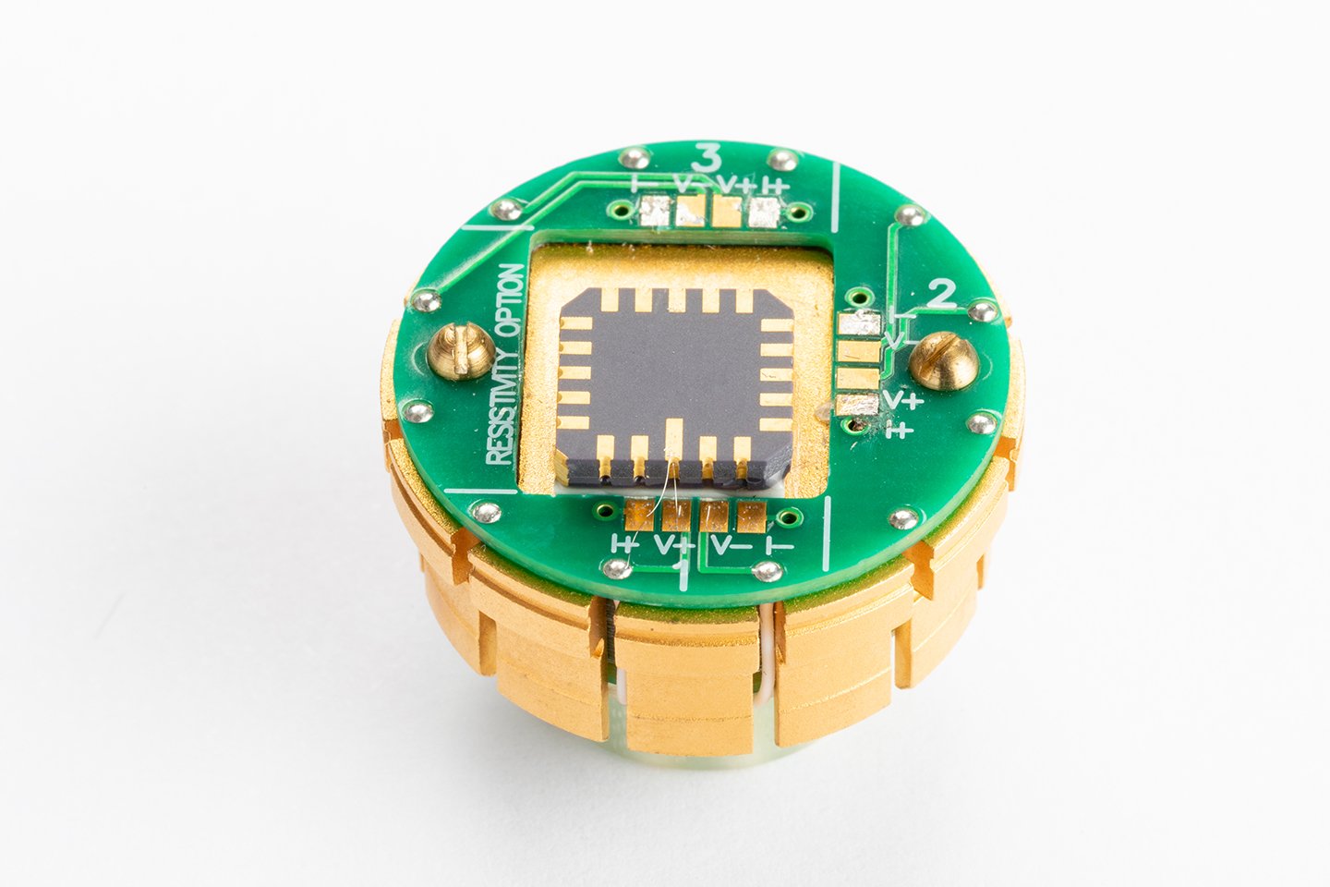
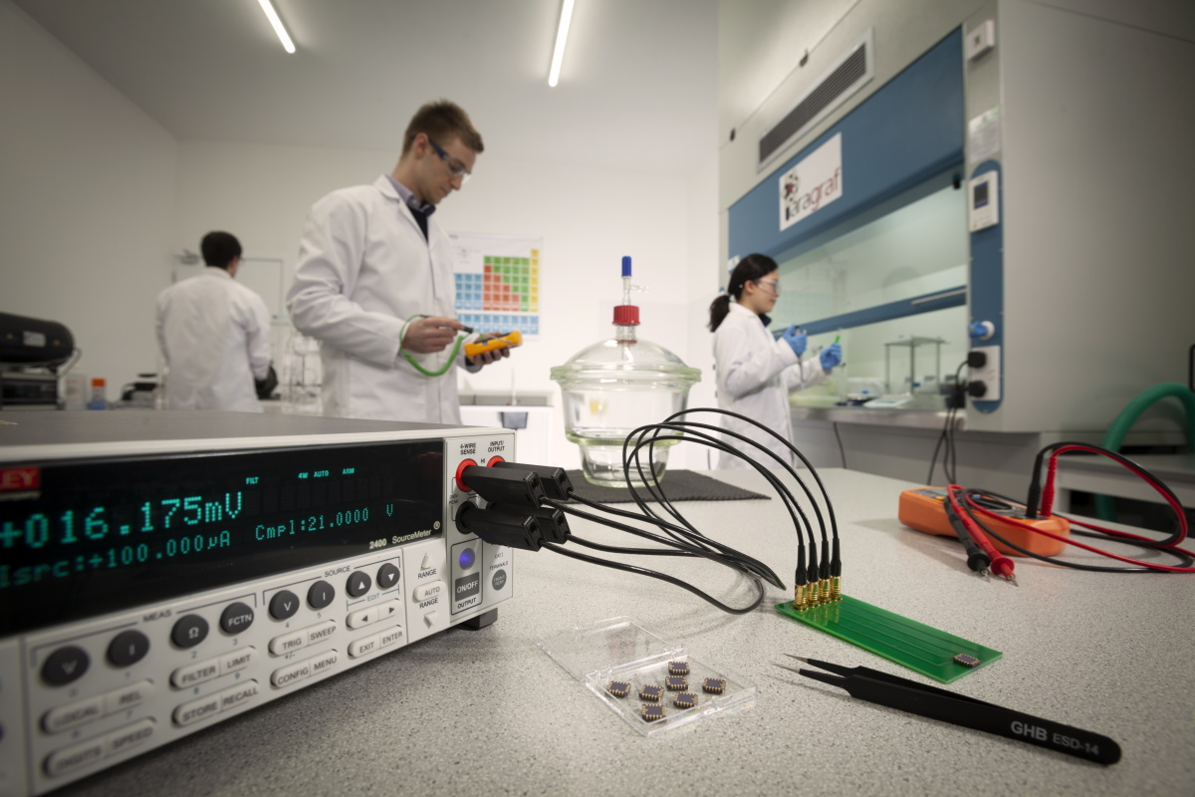
What’s next?
The graphene Hall Effect sensor’s ability to perform under high-radiation conditions will pave the way for the deployment of a broader range of electronics in harsh environments
Paragraf’s scalable manufacturing process for large-area graphene deposition means it may be possible to produce other radiation-resistant graphene-based electronic devices
Graphene Hall Effect sensors from Paragraf are now set to undergo further radiation testing (alpha, beta and gamma radiation) as well as high-frequency testing. This is expected to open-up new opportunities across critical applications such as current sensing

Slide 12
enquiries@paragraf.com
paragraf.com
+44 (0)1487 842 117
The Paragraf logo is a registered trademark of Paragraf Limited. All other trademarks are the property of their respective owners.
This document is for informational purposes only, it is not to be construed as a recommendation or a representation and no reliance should be placed on its contents.
No part of this document may be reproduced in any form without the prior written permission of Paragraf. No copies may be published, distributed or made available to any third party whatsoever without prior written permission.
Paragraf Limited
7-8 West Newlands, Somersham, Cambridgeshire, England, PE28 3EB
Company number 09889431
Copyright © 2020 Paragraf Limited. All rights reserved

